Slide 1
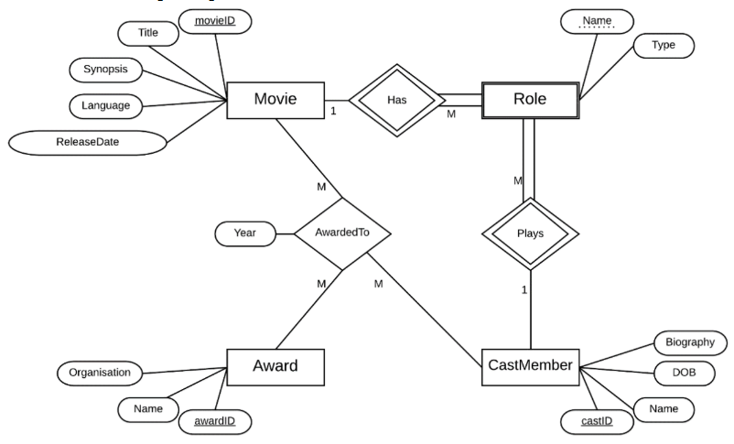

Slide 2
Claim: Each movie can receive multiple awards.
T/F?:
Justification:

Slide 3
Claim: Each movie can receive multiple awards.
T/F?: TRUE
Justification: The cardinality of MOVIE in the AwardedTo relationship is “Many”

Slide 4
Claim: The key of the Role relation will consist of 2 attributes.
T/F?:
Justification:

Slide 5
Claim: The key of the Role relation will consist of 2 attributes.
T/F?:
Justification:

Slide 6
Claim: The key of the Role relation will consist of 2 attributes.
T/F?: FALSE
Justification: The key will have 3 attributes: castID, movieID, Name

Slide 7
Claim: A CastMember can be an actor in 3 Movies.
T/F?:
Justification:

Slide 8
Claim: A CastMember can be an actor in 3 Movies.
T/F?: TRUE
Justification: Each CastMember may have many Roles

Slide 9
Claim: Each Movie can only have one director.
T/F?:
Justification:

Slide 10
Claim: Each Movie can only have one director.
T/F?: FALSE
Justification: Each Movie-Role may be done by multiple CastMembers

Slide 11
Claim: An Award cannot be given to the same Movie more than once
T/F?:
Justification:

Slide 12
Claim: An Award cannot be given to the same Movie more than once
T/F?: FALSE
Justification: Each Movie-Award combination may be awarded to multiple CastMembers

Slide 13
Claim: Awards can only be given to Movies in the year they are released
T/F?:
Justification:

Slide 14
Claim: Awards can only be given to Movies in the year they are released
T/F?: FALSE
Justification: There is no constraint on the year awards are given to Movies in this ER.

Slide 15
Claim: A CastMember may be an actor, director and producer for the same movie
T/F?:
Justification:

Slide 16
Claim: A CastMember may be an actor, director and producer for the same movie
T/F?: TRUE
Justification: Each CastMember may have multiple Roles in the same Movie.

Slide 18
Foreign Keys
Relations
TRADE-PERSON[RegoNo]
COMPANY[ACN]
Strong Entities

Slide 19
Foreign Keys
EMPLOYEE.RegoNo references TRADE-PERSON.RegoNo
SUB-CONT.RegoNo references TRADE-PERSON.RegoNo
Relations
TRADE-PERSON[RegoNo]
COMPANY[ACN]
EMPLOYEE[RegoNo, EmpNo, Position]
SUB-CONT[RegoNo]
Subclasses

Slide 20
Foreign Keys
EMPLOYEE.RegoNo references TRADE-PERSON.RegoNo
SUB-CONT.RegoNo references TRADE-PERSON.RegoNo
APPRENTICE.RegoNo references SUB-CONT.RegoNo
Relations
TRADE-PERSON[RegoNo]
COMPANY[ACN]
EMPLOYEE[RegoNo, EmpNo, Position]
SUB-CONT[RegoNo]
APPRENTICE[RegoNo, AppNo, Address, Age, Name]
Weak Entities

Slide 21
Foreign Keys
EMPLOYEE.RegoNo references TRADE-PERSON.RegoNo
SUB-CONT.RegoNo references TRADE-PERSON.RegoNo
APPRENTICE.RegoNo references SUB-CONT.RegoNo
EMPLOYEE.ACN references COMPANY.ACN
Relations
TRADE-PERSON[RegoNo]
COMPANY[ACN]
EMPLOYEE[RegoNo, EmpNo, Position, ACN]
SUB-CONT[RegoNo]
APPRENTICE[RegoNo, AppNo, Address, Age, Name]
1:N R’ships

Slide 22
Foreign Keys
EMPLOYEE.RegoNo references TRADE-PERSON.RegoNo
SUB-CONT.RegoNo references TRADE-PERSON.RegoNo
APPRENTICE.RegoNo references SUB-CONT.RegoNo
EMPLOYEE.ACN references COMPANY.ACN
CS.RegoNo references SUB-CONT.RegoNo
CS.ACN references COMPANY.ACN
Relations
TRADE-PERSON[RegoNo]
COMPANY[ACN]
EMPLOYEE[RegoNo, EmpNo, Position, ACN]
SUB-CONT[RegoNo]
APPRENTICE[RegoNo, AppNo, Address, Age, Name]
CS[RegoNo, ACN]
M:N R’ships

Slide 23
Foreign Keys
EMPLOYEE.RegoNo references TRADE-PERSON.RegoNo
SUB-CONT.RegoNo references TRADE-PERSON.RegoNo
APPRENTICE.RegoNo references SUB-CONT.RegoNo
EMPLOYEE.ACN references COMPANY.ACN
CS.RegoNo references SUB-CONT.RegoNo
CS.ACN references COMPANY.ACN
Relations
TRADE-PERSON[RegoNo]
COMPANY[ACN]
EMPLOYEE[RegoNo, EmpNo, Position, ACN]
SUB-CONT[RegoNo]
APPRENTICE[RegoNo, AppNo, Address, Age, Name]
CS[RegoNo, ACN]
Final Schema

Slide 24
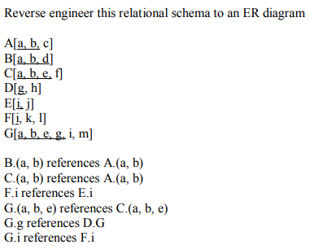

Slide 25
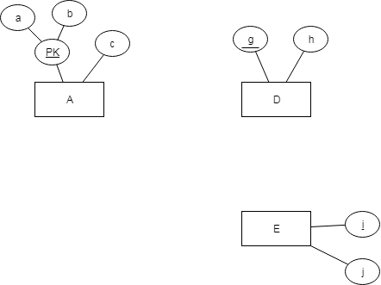
Look for Strong Entities – relations where the Primary Key does not reference any other relation
Add any attributes that are not foreign keys

Slide 26
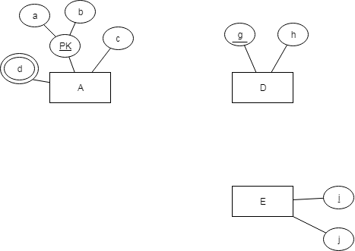
Now inspect the keys of other tables.
B has they key a,b,d. (a,b) is a foreign key, d is new. B has no non-key attributes.
This means relation B was made by a multivalued attribute d.

Slide 27
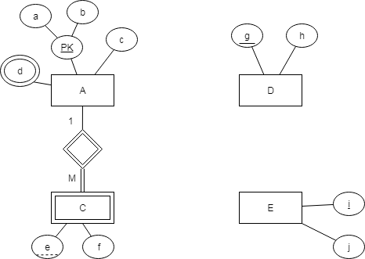
The key of C is a,b,e.
(a,b) is a foreign key, e is new.
There is a non-key attribute f.
This means that C is a Weak Entity of A.

Slide 28
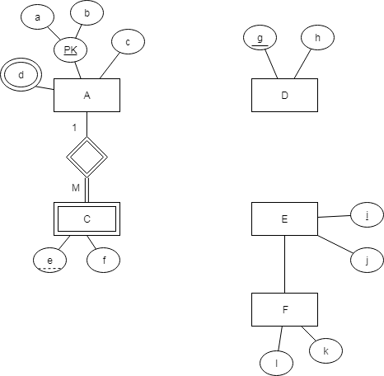
The key of F is i.
i is a single foreign key to E.
This means F is a subclass of E.

Slide 29
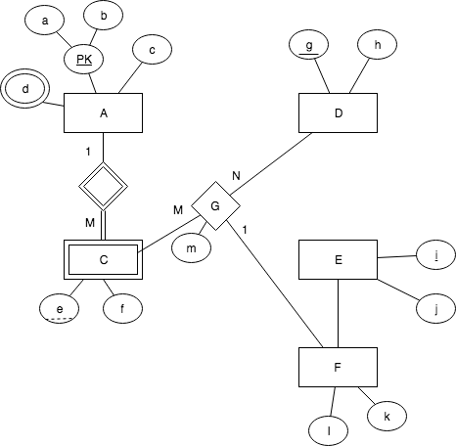
The key of G is a,b,e,g.
(a,b,e) and g are both foreign keys.
The primary key of this relation is made up of only other primary keys, therefore it is a relationship
G has foreign keys to C, D and F The foreign key to F is not a primary key so its cardinality is 1, others are M.

Slide 30
Find {A}⁺ for R[ABCDEF] given the following functional dependencies
A → BC
B → D
AC → EF

Slide 31
Find {A}⁺ for R[ABCDEF] given the following functional dependencies
A → BC
B → D
AC → EF
{A}⁺ = A
{A}⁺ = A, B, C
{A}⁺ = A, B, C, D
{A}⁺ = A, B, C, D, E, F
{A}⁺ = A,B,C,D,E,F

Slide 32
Find {A}⁺ for R[ABCDEFG] given the following functional dependencies
A→BCG
CD→E
B→F
FG→E

Slide 33
Find {A}⁺ for R[ABCDEFG] given the following functional dependencies
A→BCG
CD→E
B→F
FG→E
{A}⁺ = A
{A}⁺ = A, B, C, G
{A}⁺ = A, B, C, G, F
{A}⁺ = A, B, C, G, F, E
{A}⁺ = A,B,C,G, F, E

Slide 34
Find candidate keys for R[A, B, C, D, E] given
A → B, C
B → C, E
C → D, A

Slide 35
Find candidate keys for R[A, B, C, D, E] given
A → B, C
B → C, E
C → D, A
Left | Both | Right
In EVERY key | Might be in some keys | In 0 keys
 | A, B, C | D, E

Slide 36
Find candidate keys for R[A, B, C, D, E] given
A → B, C
B → C, E
C → D, A
Find Keys:
A, B and C are all superkeys.
A, B and C are all minimal superkeys
A, B and C are all candidate keys (or simply keys)
Left | Both | Right
In EVERY key | Might be in some keys | In 0 keys
 | A, B, C | D, E
Key | Closure | Minimal?
A | A, B, C, D, E | Yes
B | B, C, E, D, A | Yes
C | C, D, A, B, C | Yes

Slide 37
Find candidate keys for R[A, B, C, D, E, F] given
A, B → E, F
C → B
E → D, C

Slide 38
Find candidate keys for R[A, B, C, D, E, F] given
A, B → E, F
C → B
E → D, C
Left | Both | Right
In EVERY key | Might be in some keys | In 0 keys
A | B, C, E | D, F

Slide 39
Find candidate keys for R[A, B, C, D, E, F] given
A, B → E, F
C → B
E → D, C
Find keys – always look for ‘new’ keys with the FD’s. We know every key has at least “A”
AB, AC and AC are all superkeys
AB, AC and AE are all minimal
AB, AC and AE are all candidate keys (or simply keys)
Left | Both | Right
In EVERY key | Might be in some keys | In 0 keys
A | B, C, E | D, F
Key | Closure | Minimal?
A, B | A, B, E, F, D, C | Yes
A, C | A, C, B, E, F, D | Yes
A, E | A, E, D, C, B, F | Yes

Slide 40
Please post any follow up questions publicly on Piazza so the whole class can benefit from the answer ☺

